Slide 1


Internship Presentation
Name: Samit Paudel
Black Tech Software Company
Location: Zero KM, Pokhara 33700, Nepal
QA and Automation Intern

Slide 2
About the Internship
Position: QA and Automation Intern Duration: 26th Mangsir – 26th Falgun 2082 Focus Areas: Manual Testing, Automation Testing, Team Coordination Projects: RestroX ,ALD ,Simple Patro etc.
During my internship, I actively contributed to both manual and automation testing processes, ensuring the delivery of high-quality software products. I collaborated closely with development teams to identify bugs, write and execute test cases, and implement automated testing frameworks. My involvement in projects like RestroX , ALD and Simple Patro allowed me to gain hands-on experience in real-world QA practices while honing my skills in communication and cross-functional teamwork.

Slide 3
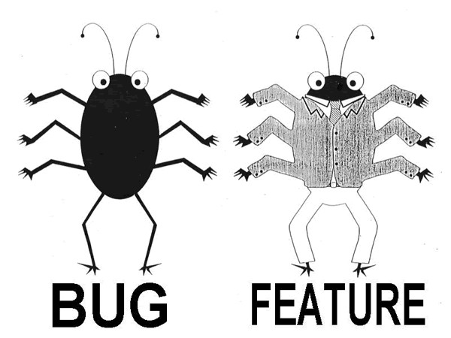
Introduction to QA
Quality Assurance (QA) is the process of making sure that software or products are free from defects (bugs) and work as expected before they are released to customers.
It ensures software reliability and performance
It is a mindset used in software development to make sure that the product meets the required quality standards before it is delivered to the user or client.

Slide 4
Types of QA Testing
1. Manual Testing
- Testing done by humans without any tools or scripts
Used for UI, usability, exploratory.
Great for catching visual and user-experience issues
Example: Clicking through a login page manually and checking for errors
2. Automation Testing
- Testing done using scripts or automation tools
Useful for repeating tests many times (like regression testing)
Saves time and improves accuracy
🧾 Tools: Playwright, Selenium, K6, JUnit
🧾 Example: Automating login and form submissions
*Note* Both is used for regression, UI, and performance testing

Slide 5
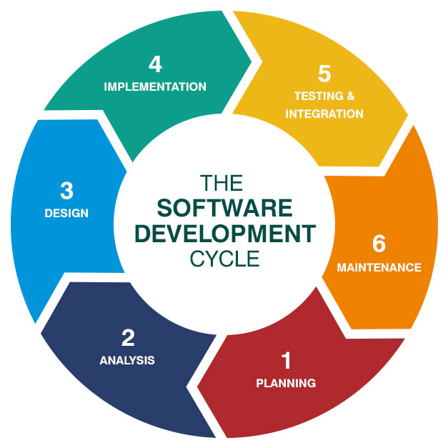
Software Development Life Cycle (SDLC)
The Software Development Life Cycle (SDLC) is a structured process used by
software developers and IT teams to design, build, test, deploy, and maintain
high-quality software systems.
Agile in SDLC
Agile is a flexible and fast way to develop software. Instead of doing everything at once, Agile breaks the work into small parts (called sprints) and improves it step by step.
Why Agile is Good:
Work is done in small steps, with quick updates
Team and clients communicate often- low documentation
Testing happens early and often, so problems are found quickly
Users give feedback regularly
A simple version of the software is delivered quickly, then improved over time

Slide 6
QA Involvement in SDLC (with Agile)
Requirement Gathering & Analysis – Understand what to test
Planning – Prepare test strategy
Design – Collaborate with dev/design teams
Development – Provide early feedback, plan automation
Testing – Execute tests (Testing ENV THEN Development Environment (Dev) version then only goes to live App )
Deployment – Do final testing in staging/production environment
Maintenance – Handle future bug fixes, Test after
updates, perform regression testing

Slide 7
Main Activities During Internship:
1. Requirement Understanding & Test Planning:
Reviewed project documents, features, and user stories.
Created detailed test plans using Google Sheets to track progress and keep everything clear.
2. Manual and Automated Testing:
Did functional, regression, and UI testing manually.
Used Playwright for automating UI tests and end-to-end processes.
Conducted performance testing with Apache JMeter to check load capacity and response times.
3. Bug Reporting & Communication:
Logged bugs and test results in shared spreadsheets and communicated them to developers.
Participated in meetings to help prioritize urgent fixes.

Slide 8
Main Activities During Internship:
4. Cross-Browser and Responsive Testing:
Checked that the application worked consistently across different devices and browsers.
5. CI/CD (Continuous Integration and Continuous Deployment) Awareness:
Learned about CI/CD pipelines and how updates are deployed to production.
Verified post-deployment features to identify any issues.
6. Collaboration & Feedback:
Worked closely with developers, designers, and other QA interns to improve the testing process and product quality.
7. Test Case Design & Execution:
Designed and ran test cases for the RestroX and ALD projects, ensuring all features were thoroughly tested.

Slide 9
Main Activities During Internship:
8. Defect Lifecycle Management:
Participated in tracking defects, from identifying problems to verifying fixes, ensuring bugs were logged and resolved properly.
9. Test Data Management:
Managed and prepared test data for both manual and automated tests to ensure realistic testing environments.
10. Collaboration with Cross-Functional Teams:
Worked with developers, product managers, and designers to understand requirements and give feedback on test results.
11. Regression Testing:
I regularly did regression testing to make sure that new updates didn’t break old features in the apps like RestroX and ALD.
Did regular regression testing to ensure new updates didn’t break existing features.

Slide 10
Main Activities During Internship:
12. Version Control Awareness:
Gained experience with version control systems like Git, learning how to handle branches and test versions.
13. Knowledge of Testing Tools & Frameworks:
Gained hands-on experience with tools like Playwright for automation, Apache JMeter for performance testing, and Google Sheets for planning and tracking.
14. Continuous Improvement & Process Refinement:
Suggested improvements to testing processes and test case designs based on my observations.
15. Documentation & Reporting:
Kept detailed records of test results, defects, and test cases for tracking and performance analysis.

Slide 11
Types of Testing
Test Type | Description | Who Does It | Focus Area
Unit Testing | Testing individual parts of the program (called units). | Developers/QA Testers | Internal logic (small parts)
System Testing | Test entire system | QA Testers | Complete functionality
Black Box Testing | Testing the software without seeing the code. Focus is on inputs and expected outputs. | QA Testers | User behavior
White Box Testing | Testing the internal code logic. Requires knowledge of how the code works. | Developers/QA | Code paths and logic

Slide 12
Test Cases
Test cases are step-by-step instructions used to verify that a software feature is working as expected.
They are essential in manual and automation testing to ensure that all functions behave correctly under different conditions.
A Test Case describes:
What to test (feature/module)
How to test it (steps and input)
What the result should be (expected outcome)
What actually happened (actual result)
Final status: Pass or Fail

Slide 13
What Does a Test Case Include?
Field | What It Means
Test Case ID | Unique number to identify the test (e.g., TC-001)
Test Case Title | Short name of what is being tested (e.g., Login with valid data)
Module Name | Which part of the software is being tested (e.g., Login page)
Test Scenario | What situation you are testing (e.g., Enter correct phone and password)
Preconditions | Things that must be ready before testing (e.g., user must be registered)
Test Steps | Actions to follow step-by-step (e.g., open login page, enter data, click)
Test Data | Input values you use (e.g., phone: 9863374281, password: 88888)
Expected Result | What should happen if everything works correctly
Actual Result | What actually happened during the test
Status | Pass ✅ or Fail ❌
Remarks | Extra notes (e.g., bug found, screenshots, suggestions)

Slide 14
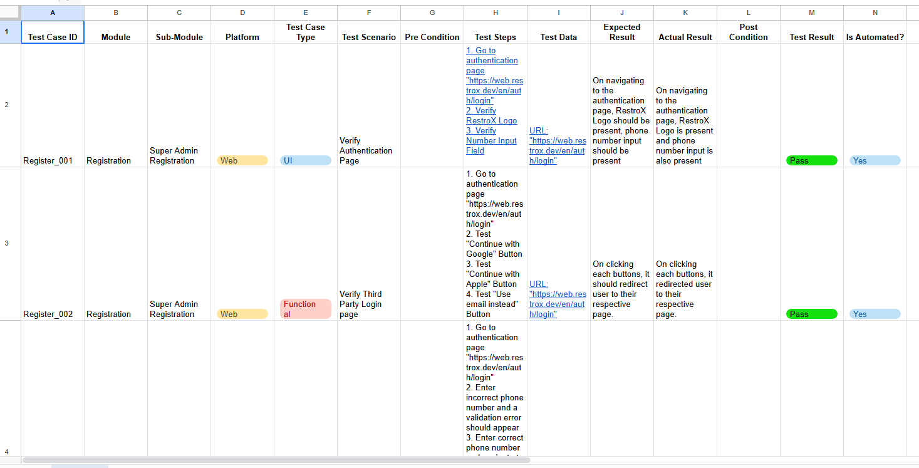
Test Case Documentation Sheet 1 – Project Testing Overview
https://docs.google.com/spreadsheets/d/1pBcVPZ0oHWocyk7VGgcmBoPp5X1KT9UmP9QbJ78l8oU/edit?usp=sharing

Slide 15
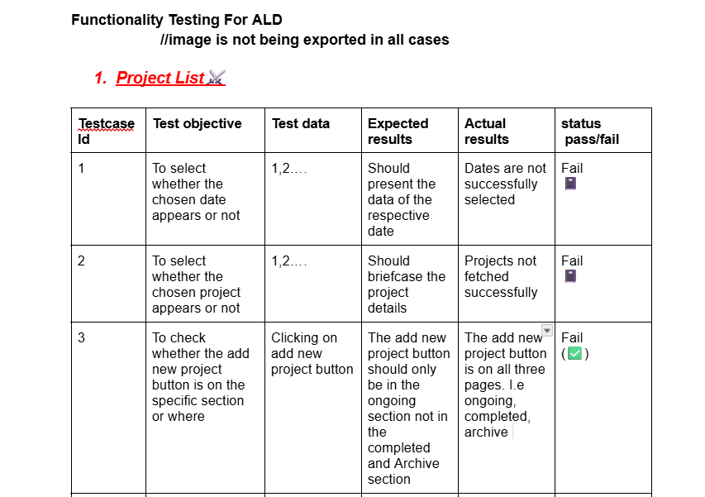
Test Case Documentation Sheet 2 – Real-Time Testing Scenarios
https://docs.google.com/spreadsheets/d/1p_VUjJibCvtLGBQeANG9_BiELFFFzz4P6V0ULQwbVuA/edit?usp=sharing

Slide 16
Tools Used For Automation
Tool | Use / Purpose
Playwright | For automating UI and end-to-end tests across browsers
K6 | For performance and load testing (check how app handles many users)
Apache JMeter | To test speed and response time of websites (RestroX)
Selenium | For browser automation (clicks, forms, navigation)
Chrome DevTools | For manual testing and debugging frontend issues

Slide 17
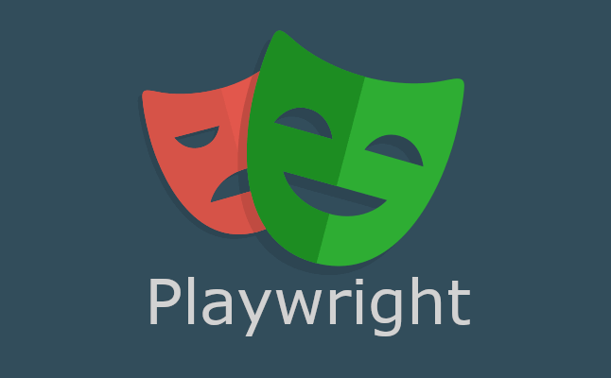
My Work with Playwright (Automation Tool)
Playwright is an open-source testing tool developed by Microsoft. It allows you to automate browsers like Chrome, Firefox, and Safari to test web applications just like a real user would.
✅ Why Playwright?
Supports multiple browsers
Fast and reliable
Works well with modern JavaScript/TypeScript frameworks
Allows screenshot and video capture for bug reports

Slide 18
Core Commands to test project from Playwright Automation Tool
Action | Command
Run all tests | npx playwright test npx playwright test --project=chromium --headed
Interactive UI | npx playwright test --ui
Specific browser | npx playwright test --project=chromium
Specific file | npx playwright test tests/google.spec.js
Debug mode | npx playwright test --debug
Generate tests (Codegen) | npx playwright codegen
View HTML report | npx playwright show-report

Slide 19
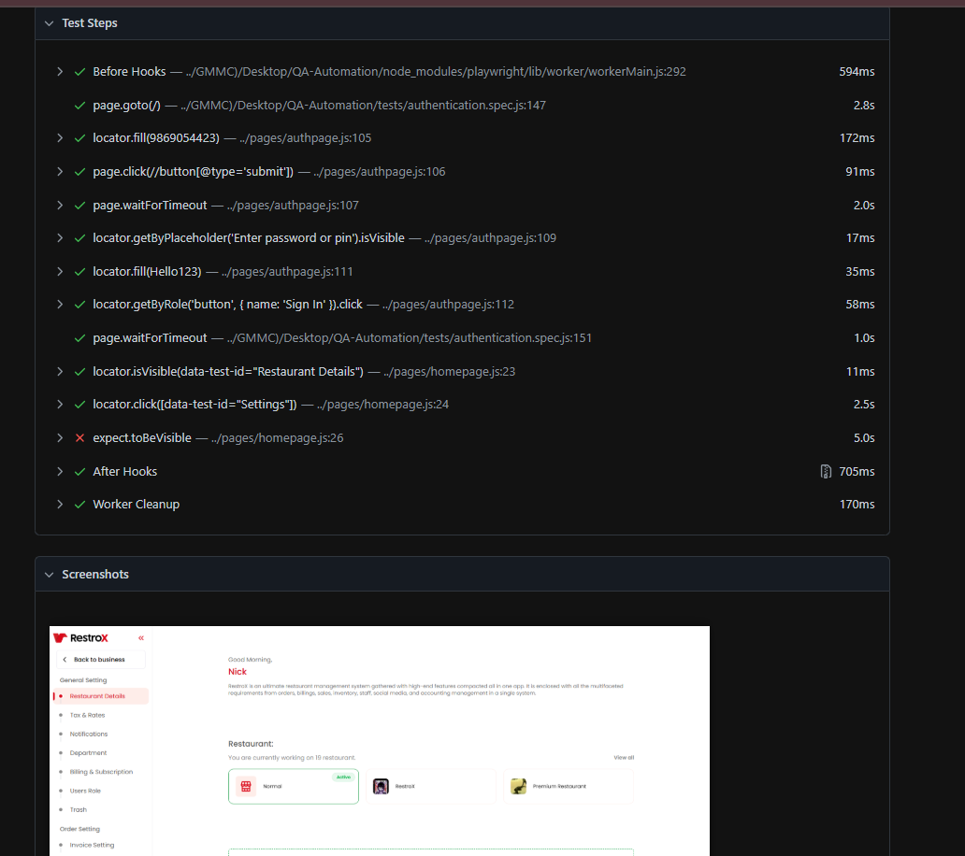
Figure : Testing System using Playwright Automation Tool

Slide 20
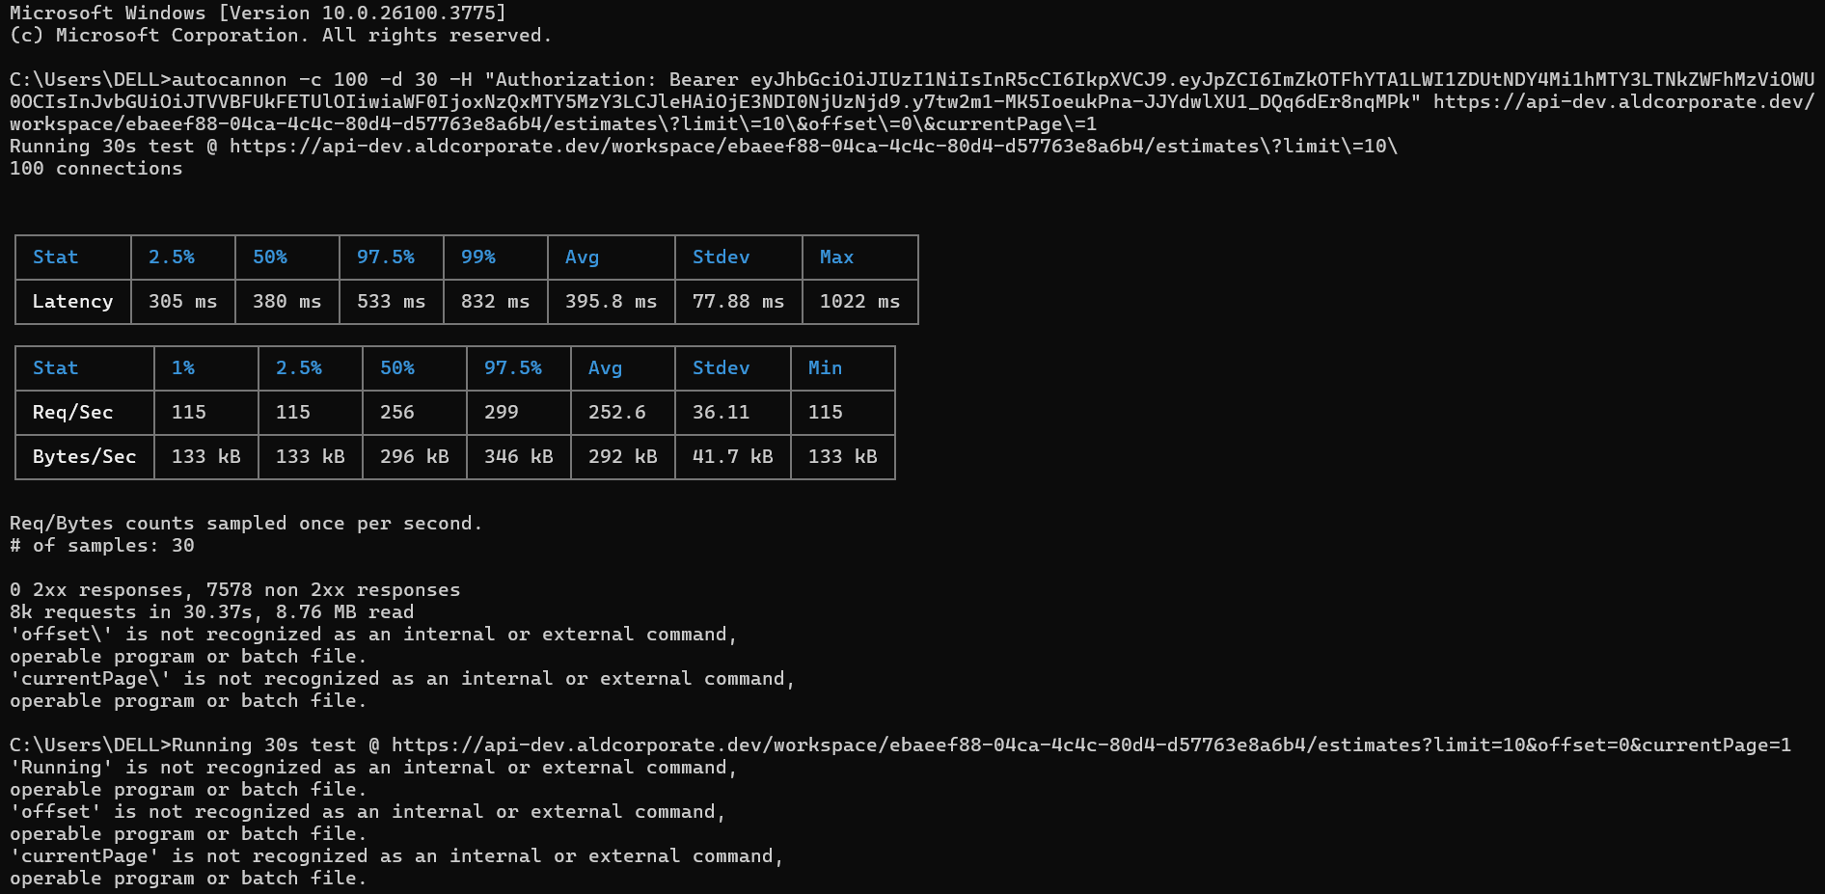
Load Testing API using Autocannon in Windows Command Prompt
This Screenshot Shows The Output Of A Load Testing Command Executed In Windows Command Prompt (Cmd.Exe) Using A Tool Called Autocannon, Which Is Commonly Used To Test The Performance And Load-handling Capabilities Of Apis Or Web Servers.

Slide 21
What I Did
Writing and executing test cases and test scenarios based on project requirements.
Performing manual testing to identify bugs and inconsistencies across different modules.
Developing and running automated test scripts using tools like Playwright and Apache J-meter.
Reporting bugs using issue tracking tools such as Jira, and collaborating with developers to ensure timely resolution.
Participating in daily stand-up meetings, sprint reviews, and retrospectives to understand agile workflows. ( 2 weeks = 1 sprint )
Assisting in regression testing before project releases to ensure that new code did not affect existing functionality.
Validating the functionality and UI/UX of applications across different browsers and devices.
Supporting the deployment team by verifying builds in staging and production environments.

Slide 22
What I Actually Test in QA
Whether buttons, forms, and links are working properly
If login and registration work correctly
Whether the app looks and works fine on different browsers
Whether the security is performing good or not.
If popups, alerts, and dropdowns behave as expected
How fast the app loads and responds
If the app can handle many users at the same time
If there are any errors in the design or layout
Whether the app works well on mobile and desktop
If the data entered gives the correct output
How we communicate and share updates with the team
Stress testing, latency testing, and similar types of performance testing in QA

Slide 23
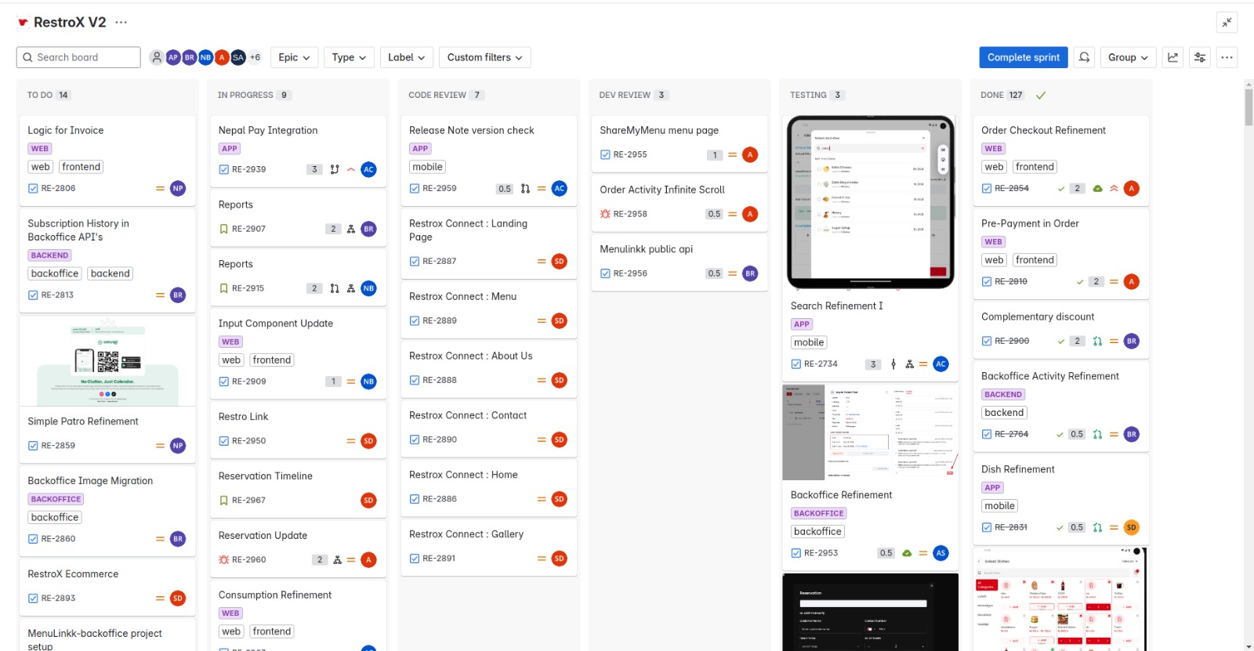
Core Project Management Tools:
1. Jira – Test & Issue Tracking
Industry-standard for bug tracking, sprint planning, and task management.
Great for linking test cases with development tickets.

Slide 24
Core Project Management Tools:
2. Slack – Real-time Communication
Integrates with CI/CD, Jira, GitHub, etc.
Use for alerts on test runs, builds, and bug discussions.
3. Notion – Documentation & QA Wiki
Store test plans, SOPs, and project notes.
Can be shared, edited, and organized easily.
4. GitHub – Code Repositories
Used to trigger test runs and version control test scripts.

Slide 25
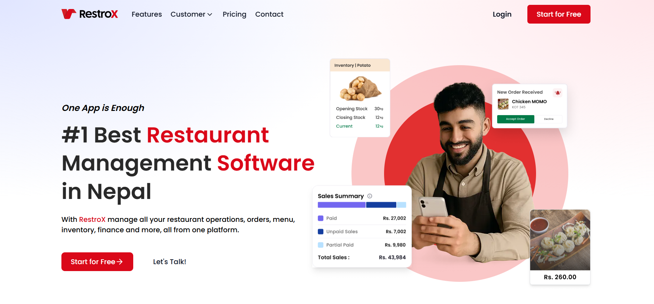
Projects I Worked On
RestroX – Restaurant Management System
Tested login, registration, order, dashboard modules ( Over All Functionalities)

Slide 26
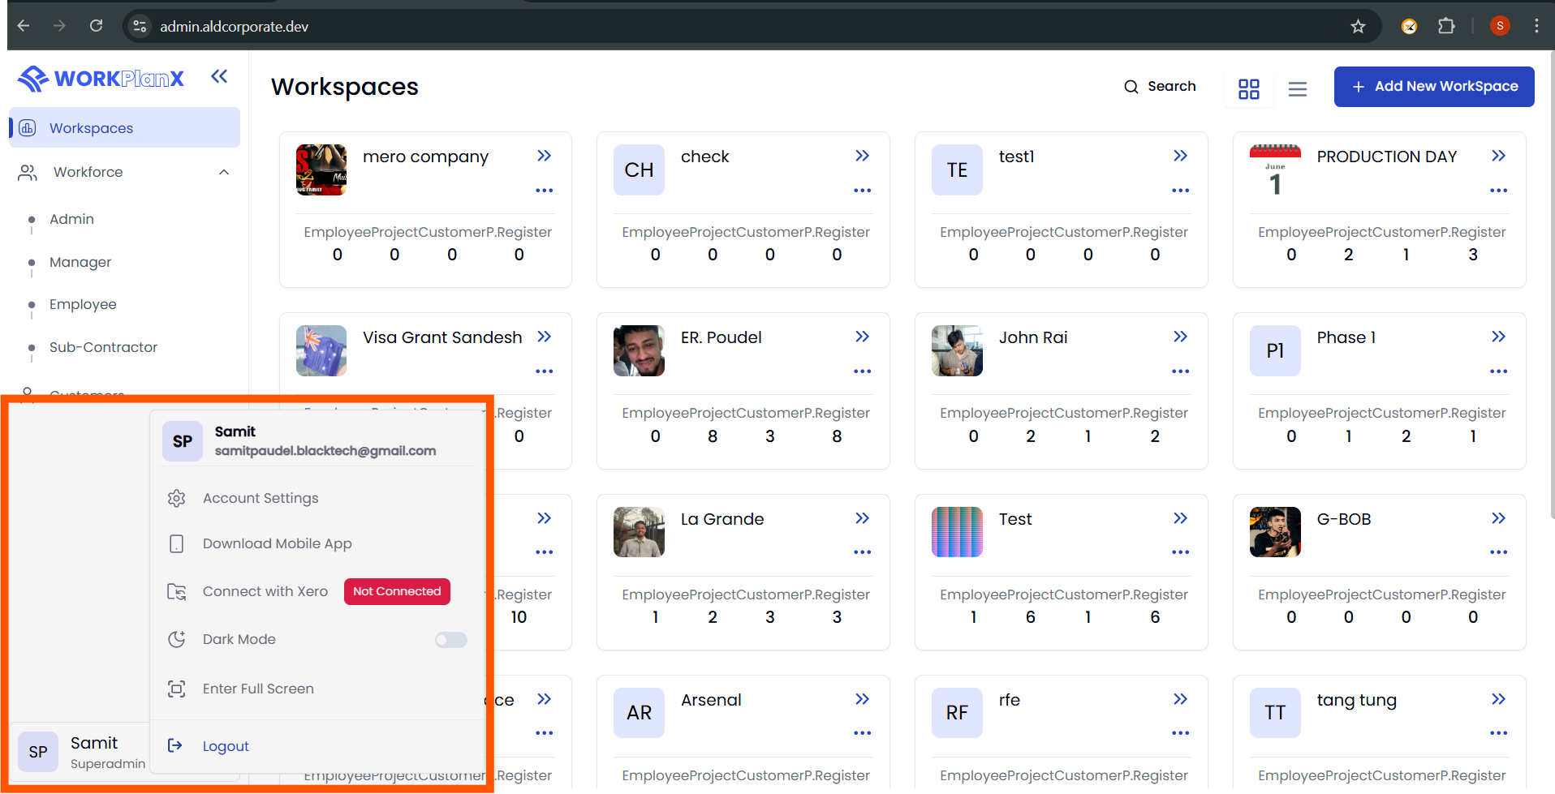
Projects I Worked On
ALD – Construction Company Platform – Destruction Company
• Validated workflows, rosters, and interfaces

Slide 27
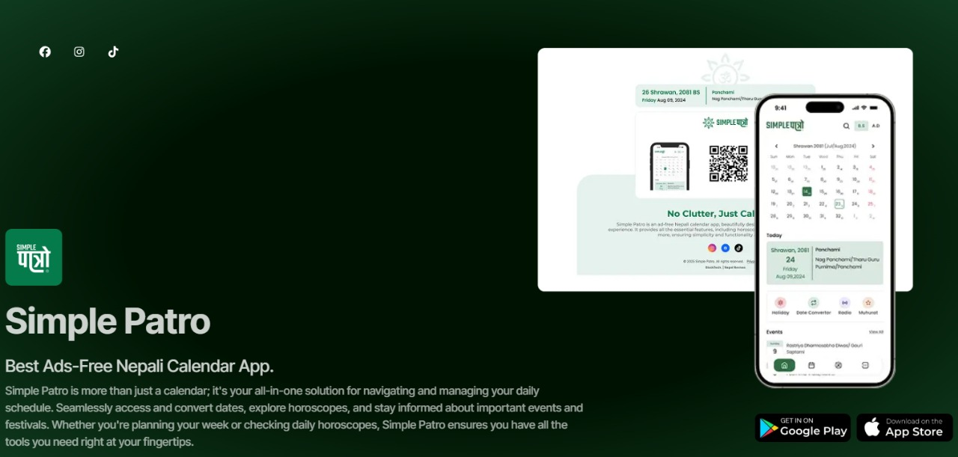
My Role as a QA at Simple Patro
UI/UX Testing – Ensure smooth, consistent, and responsive user interface across all devices and screen sizes.
Date & Calendar Accuracy – Verify correct Nepali-English date conversions, tithi events, and holiday data.
Bug Reporting – Identify, document, and report bugs with clear reproduction steps and assist developers in debugging.
Cross-Platform Testing – Test app behavior on Android and iOS for functional consistency and performance.
Release Validation – Perform final checks before each release, including smoke testing and basic automation.

Slide 28
Lessons Learned
Real-world QA practices
• Improved communication & documentation
• Collaborated with developers and designers
• Understood testing tools and environments
Conclusion
Gained hands-on QA and Automation experience
• Applied academic learning in real projects
• Learned industry tools and best practices
• Prepared for future career in QA and testing

Slide 29
Thank You

